Slide 1
Polynomial Regression

Slide 2
Polynomial Regression
Polynomial Regression is a form of linear regression in which the relationship Between the independent variable x and the dependent variable y is modeled as an nth degree polynomial.

Slide 3
Why we use polynomial Regression
Hypothesis: There are some relationship that a researcher will hypothesize is curvilinear. Clearly, if this is the case, include polynomial terms.
Visual inspection of your variables :- This is one of those reasons for always doing univariate and bivariate inspection of your data before your begin your regression analysis. A simple scatter plot can reveal a curvilinear relationship.
Inspection of residuals :- if you try to fit a linear model to curved data, scatter plot of residuals (Y axis) on the predictor (X axis) will have patches of many positive residuals in the middle. This is good sign that a linear model is not appropriate, and a polynomial may do better.

Slide 4
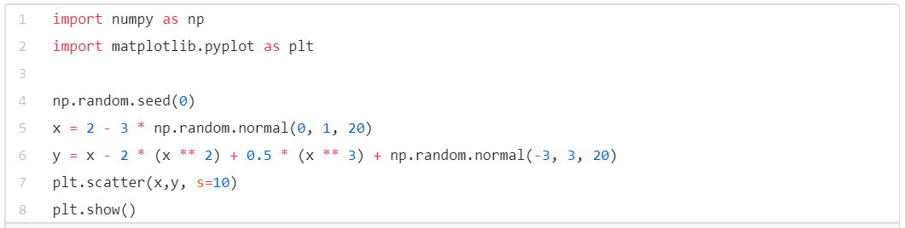
Why we use Polynomial Regression
To understand the need for polynomial regression, let’s generate some random dataset first.

Slide 5
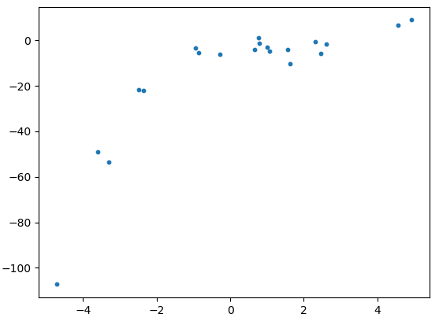
Why we use Polynomial Regression
The data generated looks like:

Slide 6
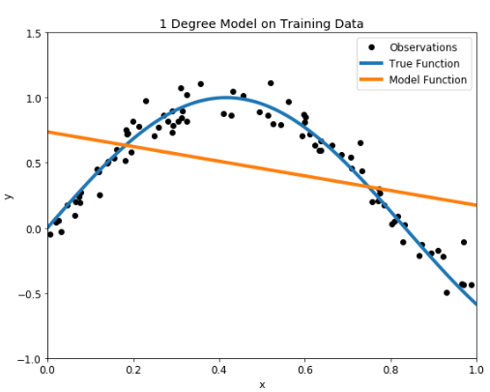
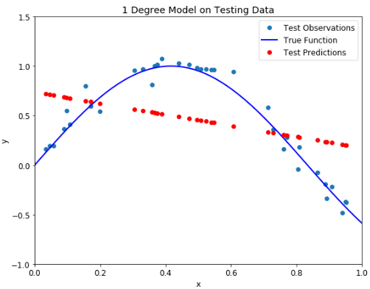
Over-fitting vs. Under-fitting
The problem of Over-fitting vs. Under-fitting finally appears when we talk about the polynomial degree. The degree represents how much flexibility is in the model, with a higher power allowing the model freedom to hit as many data points as possible. An under-fit model will be less flexible and cannot account for the data.
First up is an under-fit model with a 1 degree polynomial fit. In the image on the left, model function in orange is shown on top of the true function and the training observations. On the right, the model predictions for the testing data are shown compared to the true function and testing data points.
Under-fitting 1 degree polynomial model on training (left) and testing (right) datasets

Slide 7
Over-fitting vs. Under-fitting
Our model passes straight through the training set with no regard for the data! This is because an under-fit model has low variance and high bias. Variance refers to how much the model is dependent on the training data. For the case of a 1 degree polynomial, the model depends very little on the training data because it barely pays any attention to the points! Instead, the model has high bias, which means it makes a strong assumption about the data. For this example, the assumption is that the data is linear, which is evidently quite wrong. When the model makes test predictions, the bias leads it to make inaccurate estimates. The model failed to learn the relationship between x and y because of this bias, a clear example of under-fitting.

Slide 8
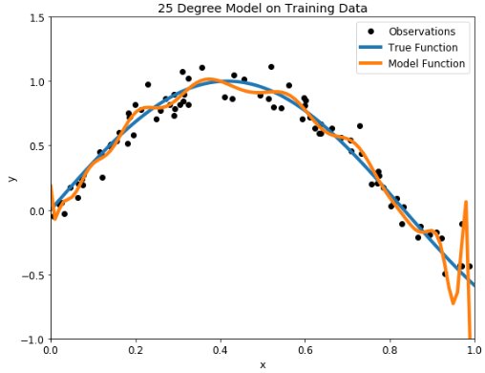
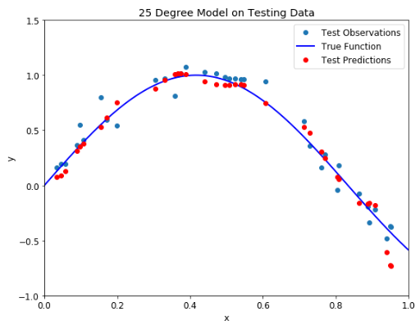
Over-fitting vs. Under-fitting
We saw a low degree leads to under-fitting. A natural conclusion would be to learn the training data, we should just increase the degree of the model to capture every change in the data.
Over-fit 25 degree polynomial model on training (left) and testing (right) datasets

Slide 9
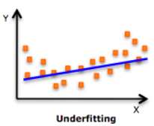
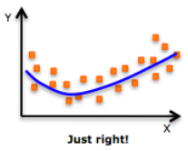
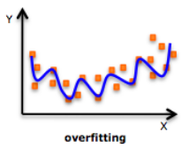
Over-fitting vs. Under-fitting
Important Points:
While there might be a temptation to fit a higher degree polynomial to get lower error, this can result in over-fitting. Always plot the relationships to see the fit and focus on making sure that the curve fits the nature of the problem. Here is an example of how plotting can help:
(especially look out for curve towards the ends and see whether those shapes and trends make sense. Higher polynomials can end up producing weird results on extrapolation.)

Slide 10
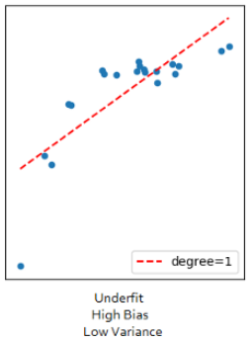
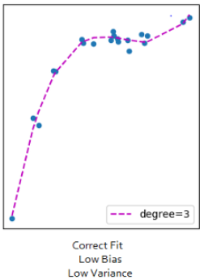
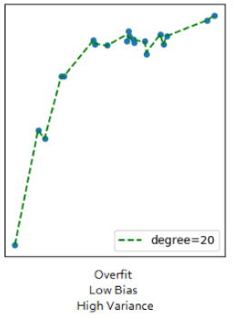
The Bias vs. Variance trade-off
Bias refers to the error due to the model’s simplistic assumptions in fitting the data. A high bias means that the model is unable to capture the patterns in the data and this results in under-fitting.
Variance refers to the error due to the complex model trying to fit the data. High variance means the model passes through most of the data points and it results in over-fitting the data.

Slide 11
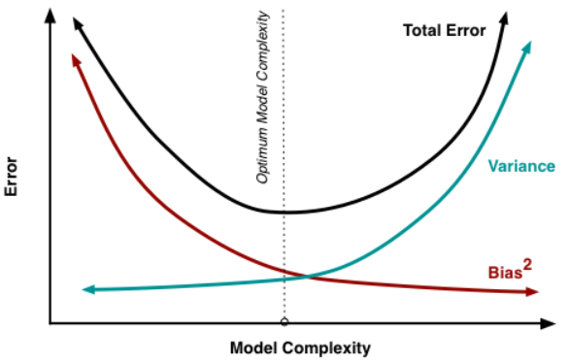
The Bias vs. Variance trade-off
From the below picture we can observe that as the model complexity increases, the bias decreases and the variance increases and vice-versa. Ideally, a machine learning model should have low variance and low bias. But practically it’s impossible to have both. Therefore to achieve a good model that performs well both on the train and unseen data, a trade-off is made.
Source: http://scott.fortmann-roe.com/docs/BiasVariance.html

Slide 12
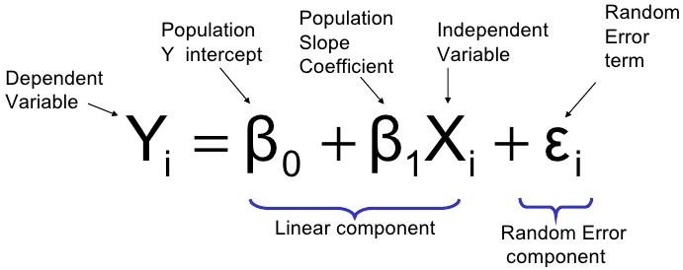
Regression Model

Slide 13

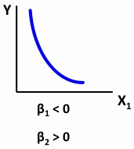
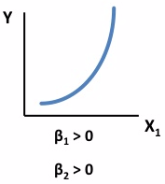
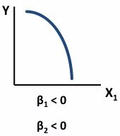
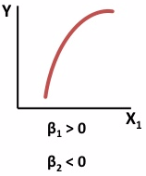

Quadratic Model
Quadratic Model may be considered when the scatter diagram takes on one of following shapes:

Slide 14

General Polynomial Regression Model
General Form:
Where :
β₀ = population regression constant
β_{i} = population regression coefficient for variable X_{j} :j = 1, 2,…k
p = order of the polynomial
ε_{i} = Model Error

Slide 15
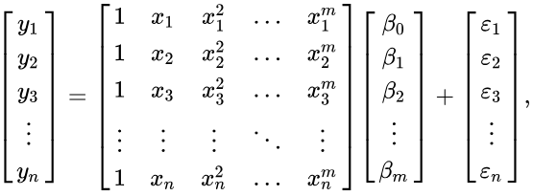
Matrix Form
The polynomial regression model
Can be expressed in matrix form in terms of a design matrix X, a response vector Y
a parameter vector β, and a vector ε of random errors. The i^{th} row of X and Y
Will contain the X and Y value for the i^{th} data sample. Then the model can be written as a system of linear equations:

Slide 16
Advantage
The biggest advantage of nonlinear regression over many other techniques is the board range of functions that can be fit.
Polynomial very flexible, and useful where a model must be developed empirically.
Polynomial fit a wide range of curvature.
Polynomial provide a good approximation of the relationship.
Transformation generally more interpretable, often more easily interpreted in terms of possible functional relationship.

Slide 17
Disadvantages
Disadvantages include a strong sensitivity to outliers. The presence of one or two outliers in the data can seriously affect the results of a nonlinear analysis.
In addition there are unfortunately fewer model validation tools for the detection of outliers in nonlinear regression than there are for linear regression.

Slide 18
Conclusion
Method of Polynomial Regression tell us about ill condition and well condition.
Evaluate the coefficient constants than we have used different techniques like LU decomposition method, Guass Elimination Method.

